Slide 1
Pizza Hut Sales Analysis – SQL Case Study
Prepared By:
Mukkamala Indu

Slide 2
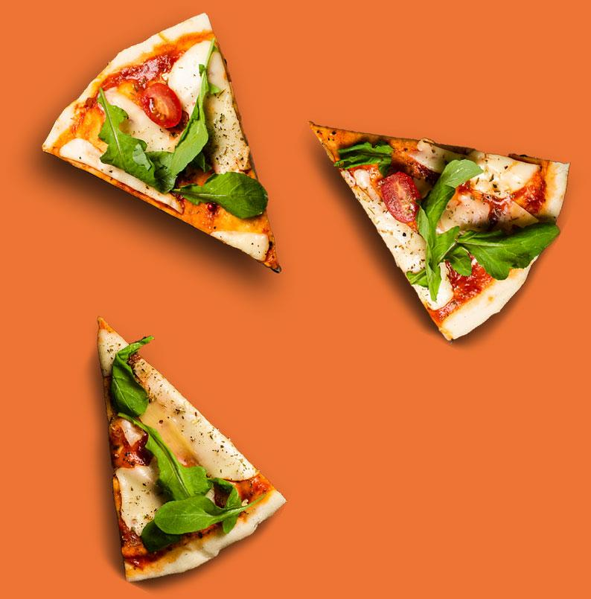
Contents
PROBLEM STATEMENT
OBJECTIVE
BUSINESS CONTEXT
DATA OVERVIEW
MODEL OVERVIEW
CASE STUDY QUESTIONS
INSIGHTS
RECOMMENDATIONS
RESOURSE
CONCLUSION

Slide 3
Problem Statement
Pizza Hut wants to understand its sales, customer choices, and revenue trends better. With many orders and different pizza types, it’s hard to know which pizzas are most popular, which categories earn the most money, and how customer orders change over time. The goal is to analyze past sales data to find useful insights. These insights will help Pizza Hut plan menus, manage inventory, run promotions, and make smart decisions to increase profits and keep customers happy.

Slide 4
Objective
This project uses SQL to analyze Pizza Hut’s sales data and gain useful business insights.
Specifically, it aims to :
Find the most popular pizzas and categories by order quantity.
Identify pizzas that generate the most revenue to focus on high-profit items.
Understand customer ordering habits,such as peak hours and preferred pizza sizes.
Check category-wise performance to improve menu planning and inventory.
Give recommendations to help Pizza Hut boost revenue and run operations efficiently.

Slide 5
Business context
Understanding customer choices and sales trends is crucial in the pizza industry. Pizza Hut offers categories like Chicken, Veggie, Classic, and Supreme.
Analyzing past sales helps:
Identify popular pizzas and plan menus.
Focus on high-profit items in marketing.
Manage inventory and reduce waste.
Plan staffing and delivery for busy times.
Run targeted promotions to boost sales and satisfaction.

Slide 6

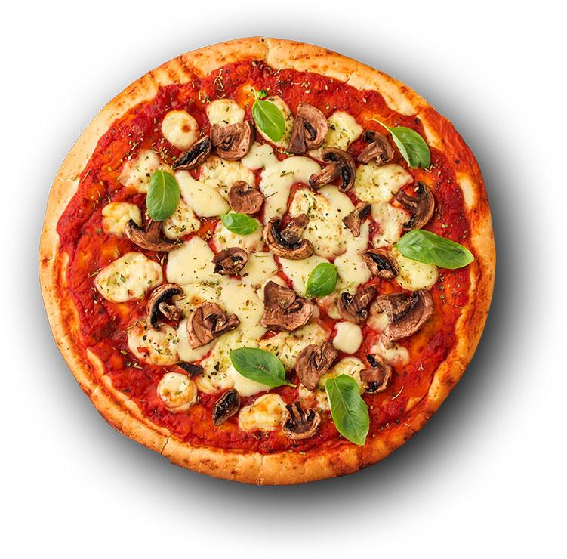
Data Overview
Pizza_Types
Pizzas
Pizza_id
Pizza_type_id
Price
size
Pizza_type_id
Name
Category
Ingredients
Orders
Order_Details
Order_id
Date
Time
Order_details_id
Order_id
Pizza_id
Quantity

Slide 7
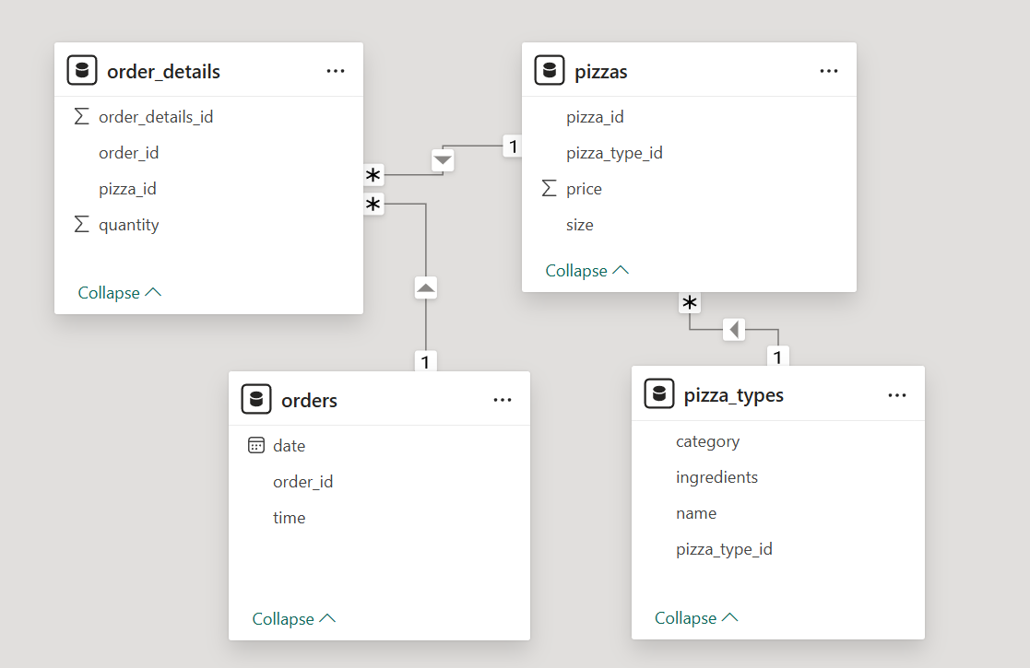
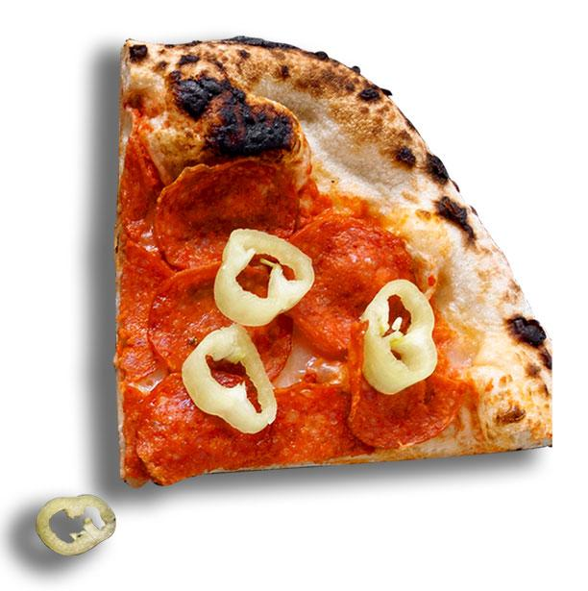
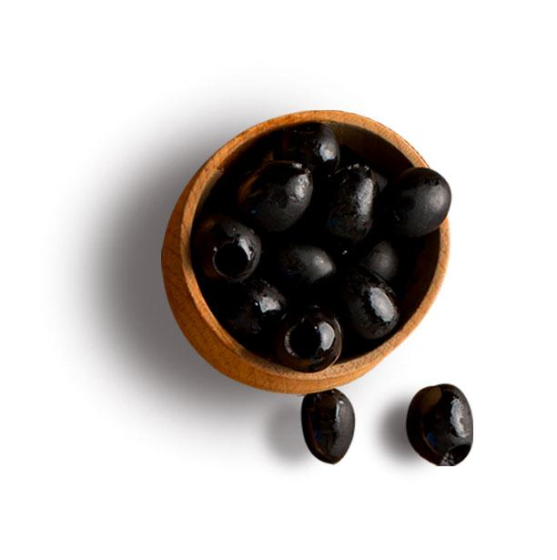
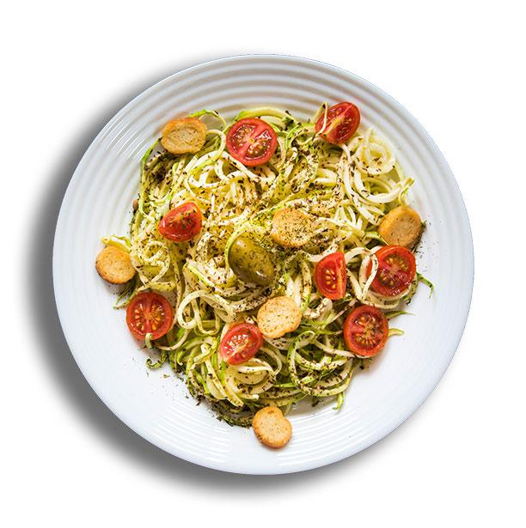
Model overview

Slide 8
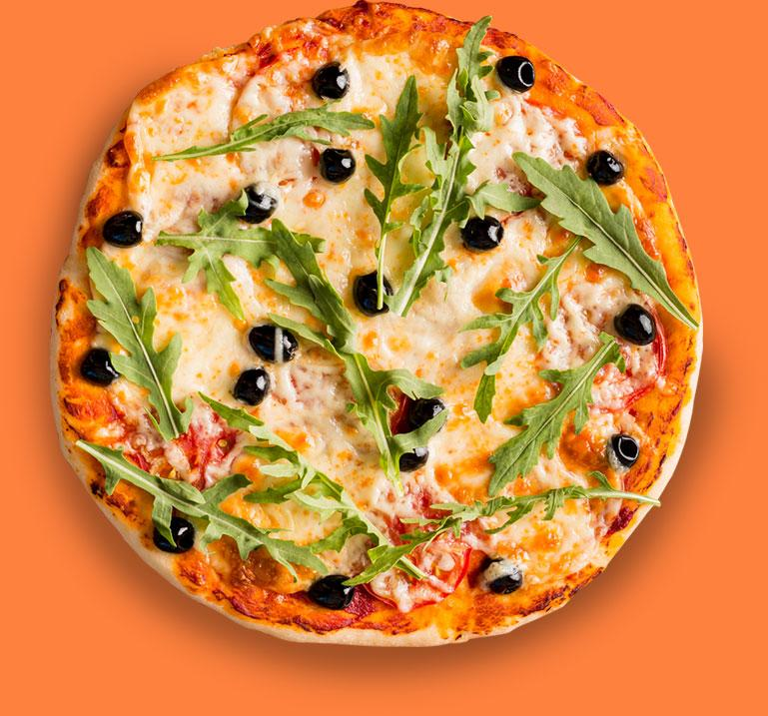
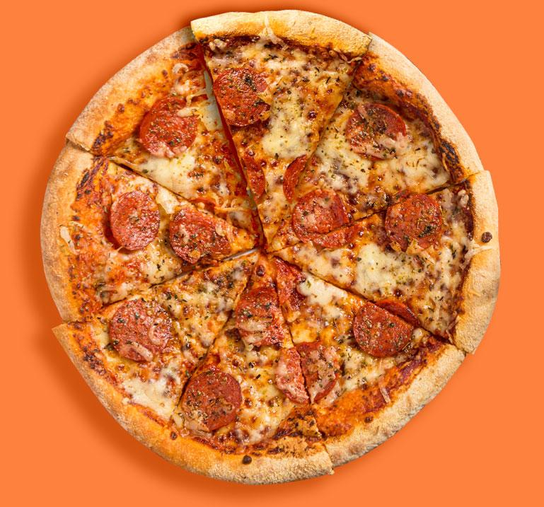

Case Study
Basic Analysis
Intermediate
Analysis
Advanced
Analysis

Slide 9
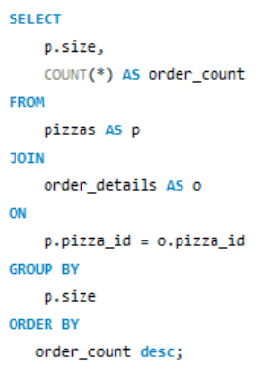
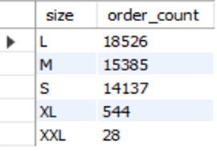
Basic Analysis
Most Ordered Pizza Size
Output →

Slide 10
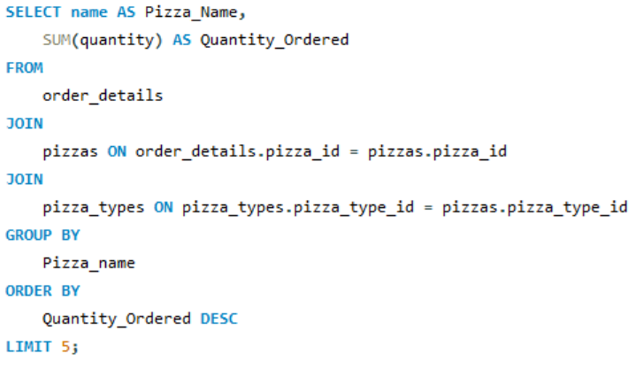
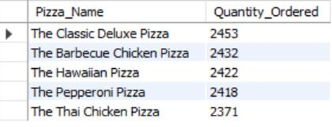
Basic Analysis
Top 5 Popular Pizzas
Output →

Slide 11
Insights
A total of 21,350 orders were placed in the year, showing good sales performance. If orders rise next year, the store might need more staff to handle the demand.
Pizza Hut earned ₹8,17,860 in total sales revenue, showing strong demand and healthy financial performance throughout the period analyzed
The Greek Pizza is the most expensive at $35.95 This shows it’s a premium item and could be promoted more to increase profit margins.
The Large size is the most ordered, showing most customers buy for two or more people. Medium and Small follow closely, while XL and XXL are rarely chosen, suggesting they could be merged into a single larger size.
The top 5 types out of the total 32 types of pizzas, ordered with maximum quantity, have almost similar quantities being ordered & make up 24.3% of the total quantity order (49574).

Slide 12
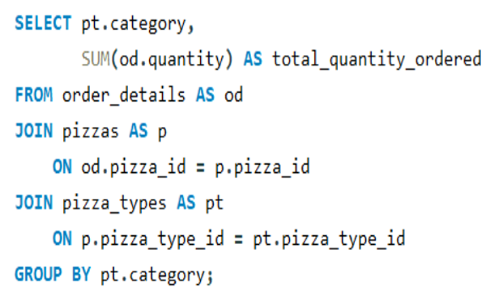
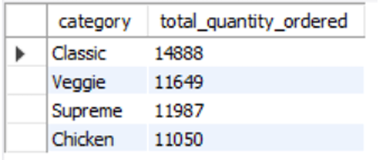
Intermediate Analysis
Pizza Quantity by Category
Output →

Slide 13
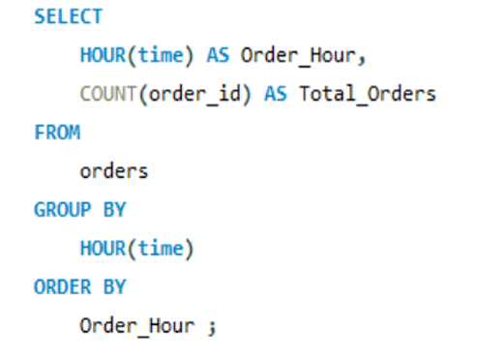
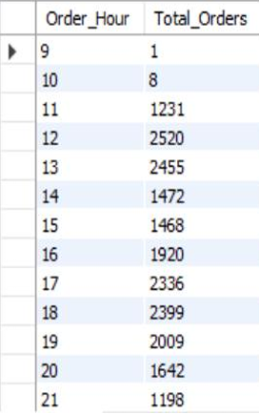
Intermediate Analysis
Order Trends by Hour
Output →

Slide 14
Insights
Classic pizzas are ordered heavily compared to the others, and hence their ingredients should be stocked well. Chicken pizza is the least ordered category in terms of quantity.
Most orders occur during lunch (12:00–13:00) and evening (17:00–19:00) hours. Sales are lowest in early morning (09:00–10:00) and late night (22:00–23:00), so fewer staff can handle these periods.
Chicken pizzas have the lowest orders, possibly due to fewer available options. Adding more chicken varieties could improve their sales.
Even with fewer options and lower quantity ordered, Chicken pizzas generate the most revenue, showing that customers are willing to pay more for them.

Slide 15
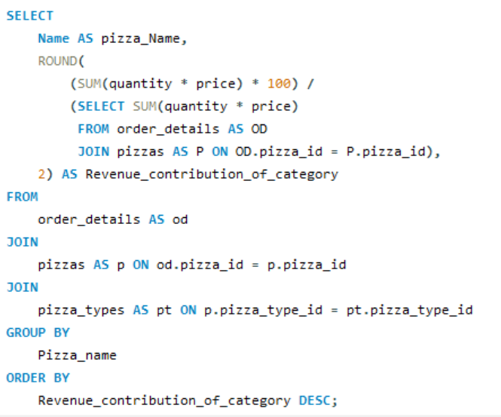
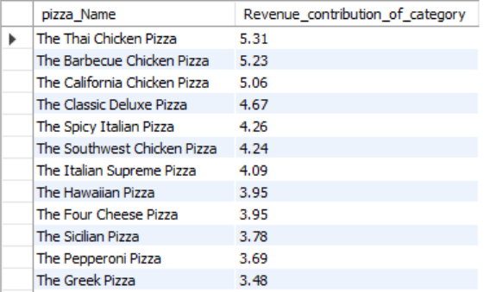
Advanced Analysis
Revenue Contribution by Pizza Type
Output →

Slide 16
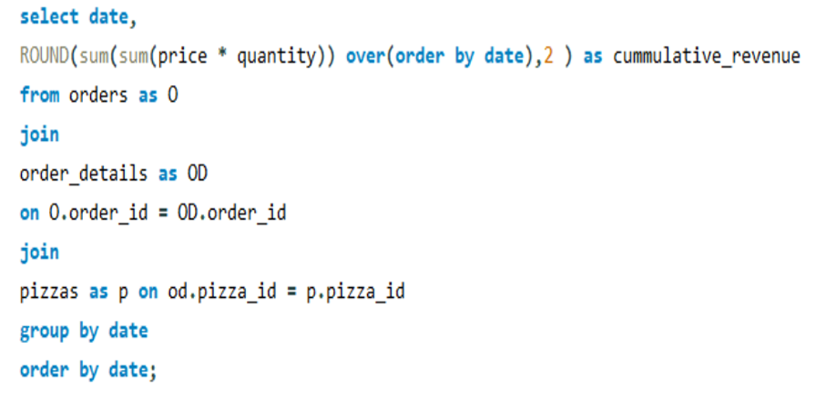
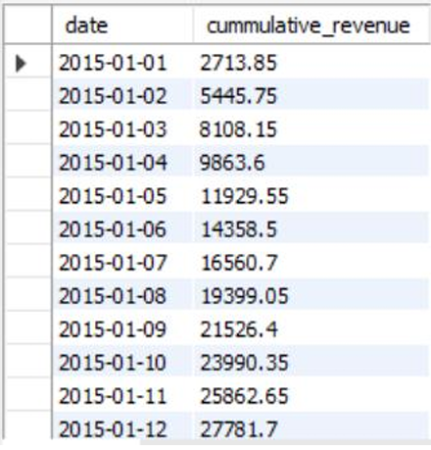
Advanced Analysis
Cumulative Revenue Over Time
Output →

Slide 17
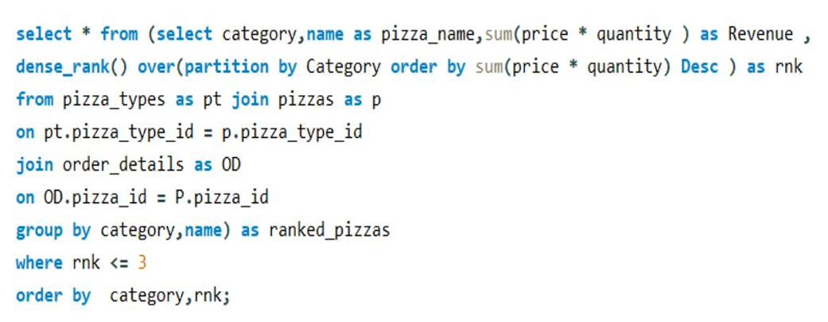
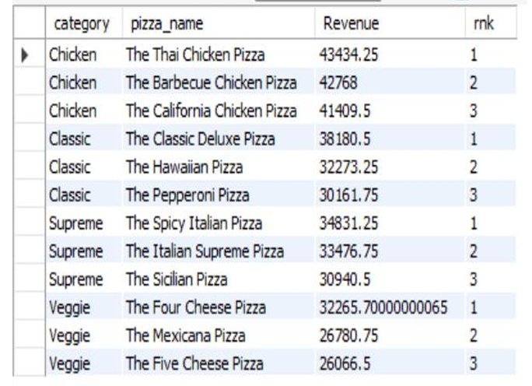
Advanced Analysis
Top 3 Pizza Types by Revenue in Each Category
Output →

Slide 18
Insights
Chicken pizzas like Thai, Barbeque, and California contribute the most to total revenue. These are the top-sellers, while pizzas like the The Brie Carre Pizza have lower sales and may need improvement or offers.
The total sales amount is increasing steadily day by day, showing that the business is performing well and customers are purchasing regularly. This consistent rise in revenue indicates strong business growth and stable customer demand.
Premium Chicken pizzas like Thai Chicken earn the most revenue despite fewer options, while Classic favorites provide steady profits. Veggie pizzas earn less on average, suggesting a need for bolder flavors to boost sales.

Slide 19

Recommendations
To attract more customers, introduce new and exciting Chicken and Veggie pizzas and Premium pizzas such as Thai Chicken and Greek Pizza should be promoted to increase profits.
Ensure large pizza sizes are well-stocked and consider merging rarely ordered XL and XXL sizes.
Staff schedules should be optimized to handle peak hours efficiently.
Maintain ingredients for top-selling pizzas to prevent shortages.

Slide 20
Conclusion
The SQL analysis helped understand customer preferences and identify ways to improve sales.
Classic and Chicken pizzas generate most of the revenue, while Veggie pizzas require better marketing and new flavors.
By enhancing menu options, optimizing staff schedules, and focusing on high-selling pizzas, Pizza Hut can increase profits and customer satisfaction.
This study demonstrates how data analysis can support better business decisions in real life.

Slide 21
Resource
Dataset Link:
https://drive.google.com/drive/folders/14IaODHUAeZX548A74cDEunsmNVL6znlc?usp= drive_link

Slide 22
ThankYou

